Slide 1
Controlling the Paper Layout:
Common Properties
Notes:
Schedule: Timing Topic
<xx> minutes Lecture
<xx> minutes Practice
<xx> minutes Total

Slide 2
Objectives
After completing this lesson, you should be able to do the following:
  Identify common paper layout properties
  Modify common paper layout properties
  Explain the use of format triggers
  Modify Web Settings properties
Notes:
Lesson Aim
<Enter lesson aim here.>

Slide 3
Selecting an Object in Lower Layers
  Accessing a Property Inspector:
  Object Navigator:
    Select object
    Double-click node icon
  Paper Design or Paper Layout view:
    Use Select Parent Frame tool
    Select Tools > Property Inspector
abc
abc

Slide 4
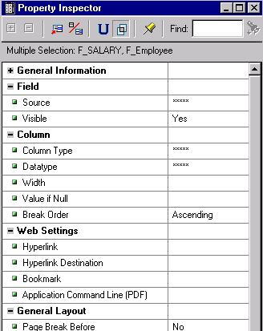
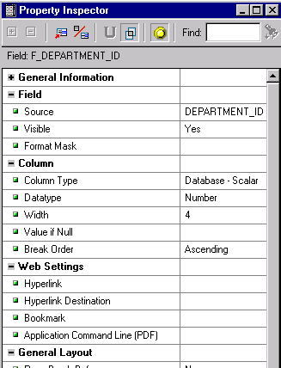
Comparing Properties
Intersection
Freeze

Slide 5
Layout Object Properties
  Four objects with common properties:
  Frames
  Repeating Frames
  Fields
  Boilerplate Objects
  Some common properties affect:
  Sizing
  Pagination
  Frequency of display

Slide 6
Sizing Objects
Layout icons
Elasticity
Vertical
Horizontal
fixed
expand
contract
variable

Slide 7


Anchors
  Objects in the push path have implicit anchors (not visible in Paper Layout)
  Explicit anchors override implicit anchors
  All anchors appear in Object Navigator
Implicit (shaded)
Explicit (solid)

Slide 8
Layout Object Relationships
1
2
3

Slide 9
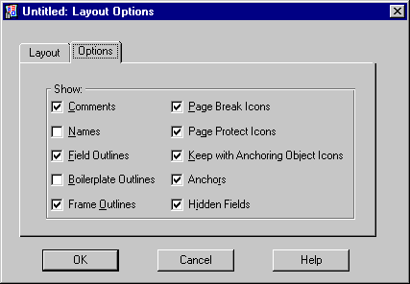
Pagination Icons in the Paper Layout

Slide 10


Using Page Break Before
-1-
1

Slide 11
Using Page Break Before
-1-
1
-2-
xxx
xxx

Slide 12
Using Page Break Before
-1-
1
-2-
xxx
xxx
-1-
2

Slide 13
Using Page Break Before
-1-
1
-2-
xxx
xxx
-1-
xxx
xxx
-2-
2

Slide 14
Using Page Break After
-1-
xxx
xxx
1
-1-
xxx
xxx
-2-
2

Slide 15
Using Page Protect
f_dept_id
Employee
f_ename

Slide 16
Using Page Protect
-1-
40
xxxxxxxx
xxxxxxxx
f_dept_id
Employee
41
xxxxxxxx
xxxxxxxx
xxxxxxxx
xxxxxxxx
-2-
f_ename

Slide 17
Controlling Print Frequency
-1-
Your Company
Your Company
-2-
Your Company
-3-
Your Company
Print Object On = All Pages
Base Printing On = Enclosing Object

Slide 18
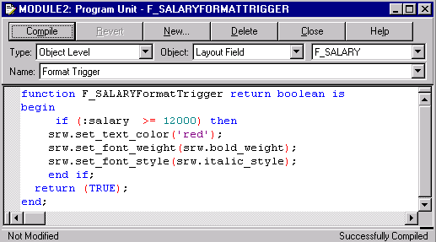
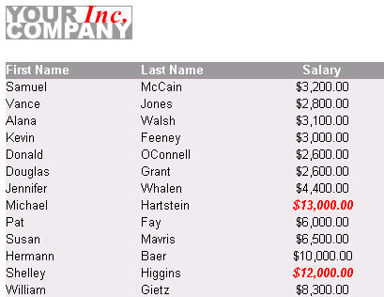
Format Triggers

Slide 19
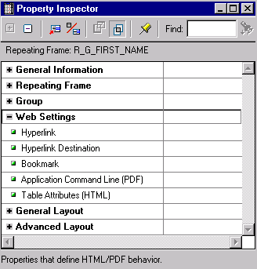
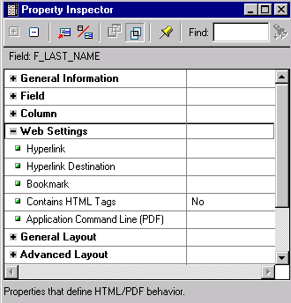
Layout Object Properties for Web Support
  Hyperlink
  Hyperlink Destination
  Bookmark
  Application Command Line

Slide 20
Summary
  In this lesson, you should have learned how to:
  Identify common properties for most layout objects:
    Size
    Pagination
    Print frequency
    Format trigger
    Web settings
  Modify common properties for special reporting needs

Slide 21
Practice 12 Overview
  Creating a break report with continuation pages displaying limited information
  Modifying properties for object Web support

